Slide 1
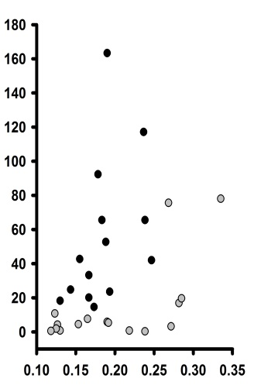
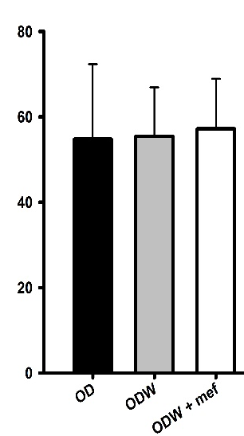
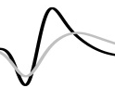
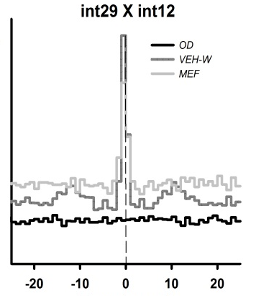
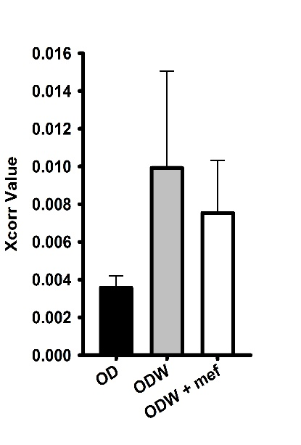
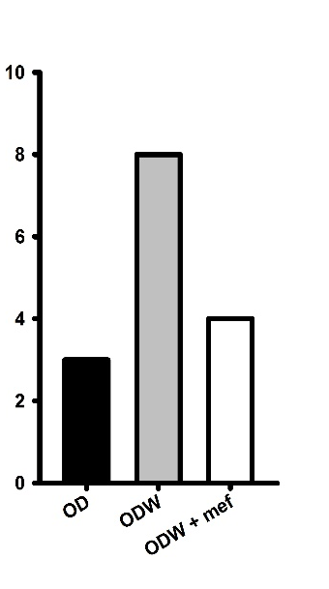
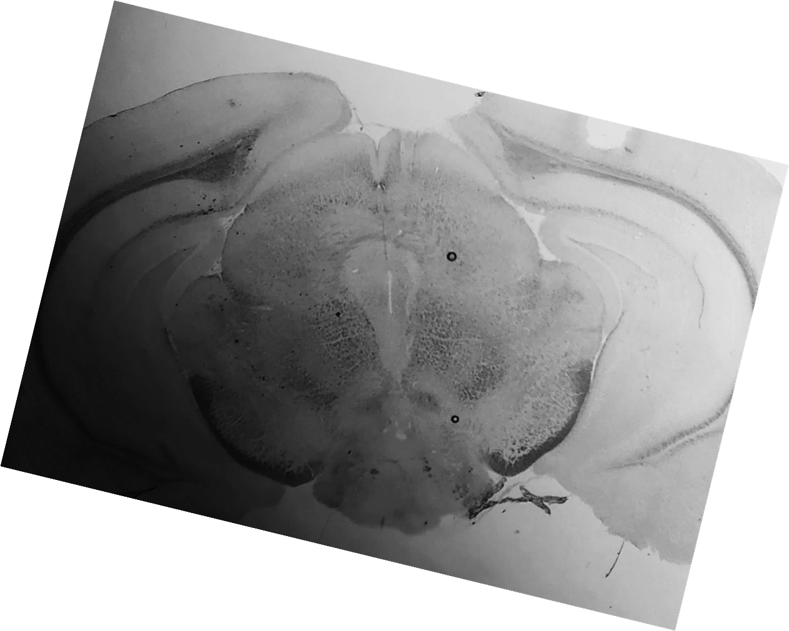
Figure X
A
Putative
GABAergic
Putative
Dopaminergic
B
C
*
*
Gb29 X Gb12
OD
*
ODW
*
ODW + mef
Spikes / second
Spikes / second
Relative Correlation strength
Peak to trough time (msec)
OD
ODW
Time (msec)
ODW + mef
D
E
F
Bregma -2.92
Xcorr value
Occurrence
OD
ODW
OD
ODW
ODW + mef
ODW + mef

